Slide 1
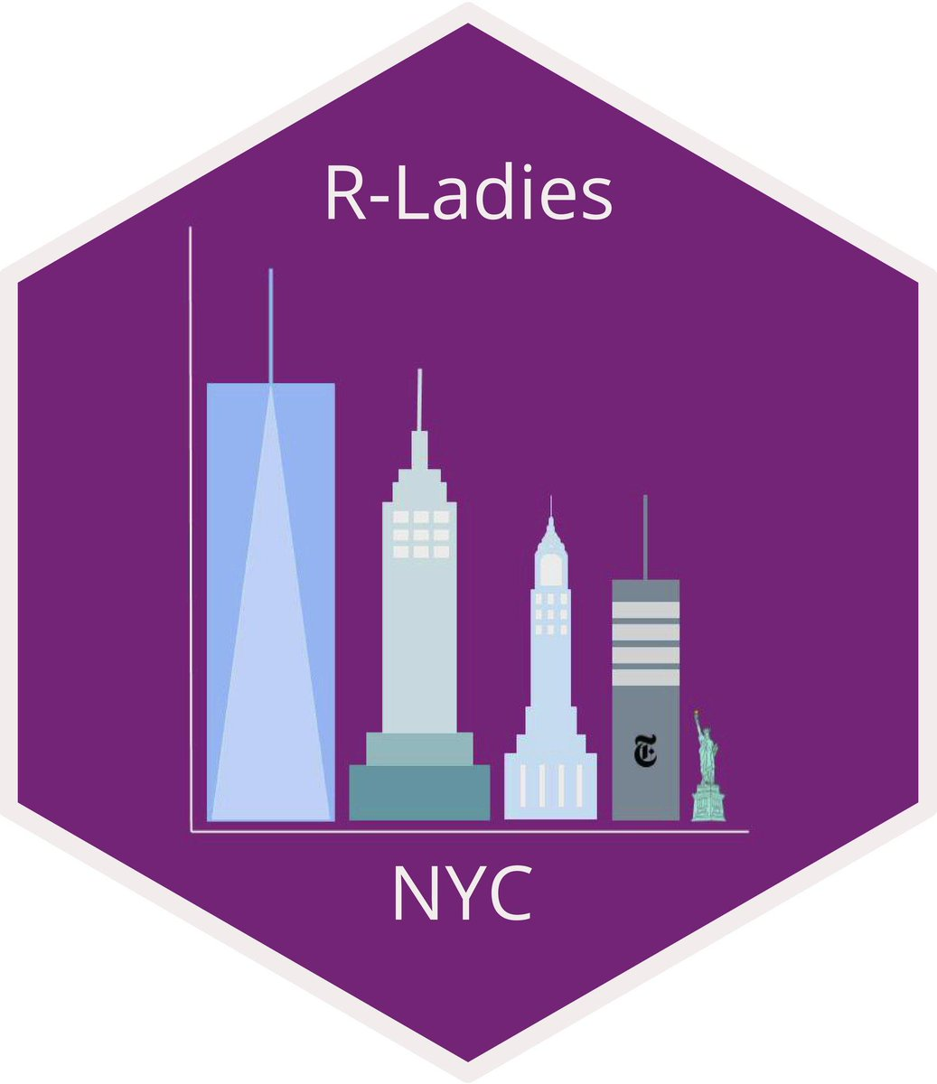
It’s Time to Shine with the timetrackR App
February 26, 2020
Jessica Lavery
Biostatistician

Slide 2
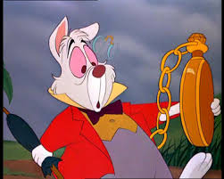
Time & the busy RLady
Often feels like there aren’t enough hours in the day
Start working on one project and loose track of time
Re-analyses take up time! There is no such thing as a “quick re-analysis”!

Slide 3
Why use a time tracker summary/project management app?
Tracking your time is only useful if you then go back and revisit it (except for the case of time tracking for billing purposes)
Useful for one on ones and project status updates
Sometimes useful for effort certification reports if your organization requires them

Slide 4
Tracking time
Doesn’t have to be down to the minute
At most granular, 15 minute increments
At least granular, entire day

Slide 5
The app

Slide 6
Time management metrics
Gives a breakdown of time spent per area of project by project and investigator
If an investigator or project is taking up >50% of your time, you want to know that
If an abstract took as long as a full analysis for a manuscript, you want to know that too

Slide 7
Information gleaned from timetrackR

Slide 8
Caveats
The obvious: this is only useful if you track your time
Entirely retrospective, it’s a summary of what you’ve done, doesn’t include projected time allocations
Most useful for projects with a start and end, but can be useful for ongoing work as well

Slide 9
Adapting the app for your own use
Can track whichever components of your time you’re interested in
Can be used to summarize “current” time (active projects) or view long-term project trajectories

Slide 10
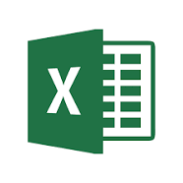
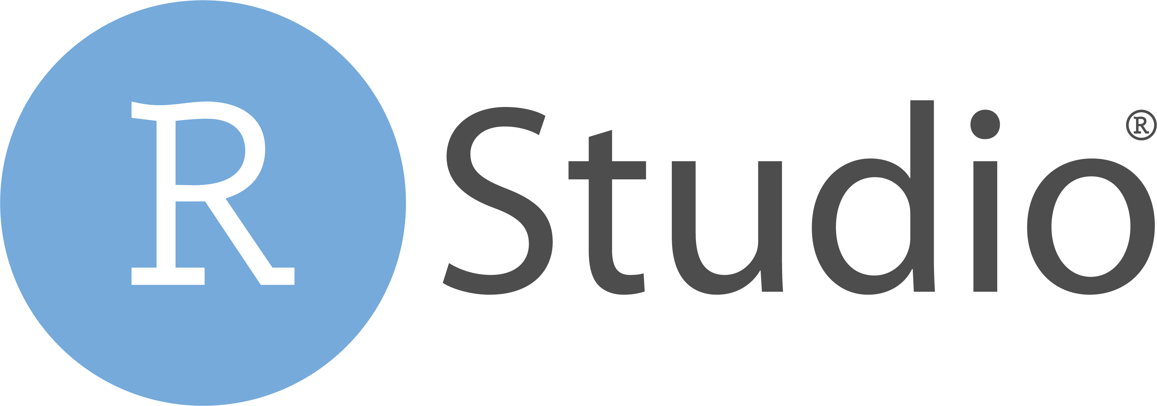
CODE
Excel spreadsheet setup

Slide 11
CODE

Slide 12
Alternative solutions: Pros & cons
Other time tracking software & reporting is available:
Toggl (free and paid versions), RescueTime, Everhour
Pros to DIY Shiny App:
Entirely customizable
Free!
Pros to other software/trackers:
Less labor intensive/maintenance not required
Can monitor apps and URLs used and identify distracters (hello Slack!)
More precise: down to the minute (if this is desired)

Slide 13
Future plans
Incorporate with Toggl app to automate a portion of the tracking
Automated + customizable: best of both worlds?
Incorporate additional visualizations and/or summary measures
Suggestions?

Slide 14
References
GitHub Repo: https://github.com/jalavery/proj_mgmnt

Slide 15



Thank you!
laveryj@mskcc.org
@jessicalavs
www.JessicaLavery.com

